Slide 1

OS2, week 2
The readers-writers problem

Slide 2
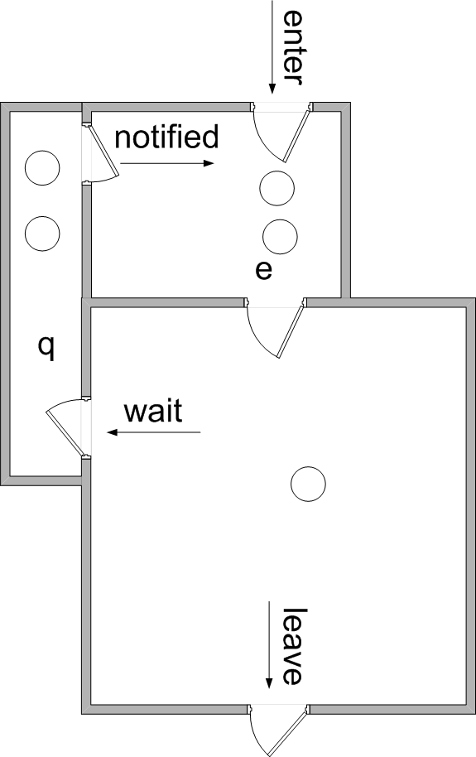
wait in while
Why use while-statement for wait()?
After wait, thread goes into ‘q’
After notify, thread leaves ‘q’ and goes to ‘e’ to wait for its turn
Things can change in the meantime
When thread leaves ‘e’, it is not sure that it is still allowed to continue
Therefore:
check condition again
wait again if necessary
thread C:
{
list.add();
notifyAll();
}
thread A:
{
if (list.isEmpty())
wait();
list.get();
}
thread B:
{
if (list.isEmpty())
wait();
list.get();
}
thread A:
{
while (list.isEmpty())
wait();
list.get();
}
thread B:
{
while (list.isEmpty())
wait();
list.get();
}

Slide 3
Some remarks
If versus while
Use a while when we have multiple threads of one type that invoke the method
(in the previous slide, two consumers that call the get method)
Use an if when we have only one thread that invokes the method
Check OS1 week 6-2 presentation (in particular slide 30-33)

Slide 4
Summary: 1. one producer / one consumer
Result:
class BufferWrong {
private int n;
private boolean bufferFull = false;
synchronized int get() {
if (!bufferFull)
wait();
System.out.println("Get: " + n);
bufferFull = false;
notify(); // notify producer
return n;
}
synchronized void put(int n) {
if (bufferFull)
wait();
this.n = n;
System.out.println("Put: " + n);
bufferFull = true;
notify(); // notify consumer
}
}

Slide 5
Summary: 2. more producers / one consumer
Result:
class BufferWrong {
private int n;
private boolean bufferFull = false;
synchronized int get() {
if (!bufferFull)
wait();
System.out.println("Get: " + n);
bufferFull = false;
notify(); // notify producer
return n;
}
synchronized void put(int n) {
while (bufferFull)
wait();
this.n = n;
System.out.println("Put: " + n);
bufferFull = true;
notifyAll(); // notify everyone
}
}

Slide 6
Summary: 3. one producer / more consumers
Result:
class BufferWrong {
private int n;
private boolean bufferFull = false;
synchronized int get() {
while (!bufferFull)
wait();
System.out.println("Get: " + n);
bufferFull = false;
notifyAll(); // notify everyone
return n;
}
synchronized void put(int n) {
if (bufferFull)
wait();
this.n = n;
System.out.println("Put: " + n);
bufferFull = true;
notify(); // notify consumer
}
}

Slide 7
Summary: 4. more producers / more consumers
Result:
class BufferWrong {
private int n;
private boolean bufferFull = false;
synchronized int get() {
while (!bufferFull)
wait();
System.out.println("Get: " + n);
bufferFull = false;
notifyAll(); // notify everyone
return n;
}
synchronized void put(int n) {
while (bufferFull)
wait();
this.n = n;
System.out.println("Put: " + n);
bufferFull = true;
notifyAll(); // notify everyone
}
}

Slide 8
Some remarks
Note that we only have a synchronization problem if
there is at least one writer
so a thread that changes the data
cf a database, where you do only reads.
(-> no synchronization problem)

Slide 9
Readers-Writers Problem
A data set is shared among a number of threads
Two types of threads:
Readers
They only read the data set; do not perform any updates
Writers
They change the data set (and perhaps read as well)
Restriction:
Writers must be alone:
allow unlimited number of readers at the same time, but without a writer
allow only one writer; no other writers at the same time
allow no readers and writers together
Notes:
9
Semaphore solution: see book
Synchronized solution: see book/demo
Next: JAVA reentrantlock & conditions

Slide 10
Solution with a Monitor
What do we mean by a 'Monitor'?
All synchronization issues are concentrated in a Monitor:
(Note: there is no standard class with name Monitor)
A monitor is ‘just’ a class, with some special features:
it contains all shared state variables (private) (Not the dataset)
it contains all synchronization code
It has one public method for every synchronization event
all these methods are synchronized
methods can contain wait/notify/notifyAll
usually, only one object is made of this class
this object is shared by all threads
Notes:
Why not put the dataset in the monitor?
That would prevent multiple readers from accessing the shared data
For which points are synchronization methods needed?

Slide 11
Some remarks
Why do we use a monitor?

Slide 12
Some remarks
Why do we use a monitor?
we want to allow multiple threads to enter the critical section
or if we want to claim multiple resources/locks in one go (week 5)
other reason: separation of concerns (all sync in one class)
!! Share the monitor among the threads

Slide 13
Readers-Writers Monitor
Make a class ReaderWriterMonitor with 4 methods:
enterReader()
exitReader()
enterWriter()
exitWriter()

Slide 14
Structure of a reader/writer
General structure of a reader:
while(true) { RW.enterReader(); ... // read dataset (CS) RW.exitReader(); }
General structure of a writer:
while(true) { RW.enterWriter(); ... // update dataset (CS) RW.exitWriter(); }
More complicated if reader/writer can be interrupted in CS

Slide 15
Some remarks
Note that with a monitor only the entry/exit of a critical section is synchronized, not the critical section itself.
So more generic solution than synchronizing the whole method.
in the monitor enterCS methods we specify the entry conditions
and notice we use a wait here (compare with the producer/consumer problem, although the thread may enter the CS, another thread / other threads should first leave the CS before the thread can continue)
exitCS methods are needed to notify (wake up) waiting threads
`and of course, in all methods: update internal administration
(nr of readers in CS, etc).

Slide 16
Some remarks
One remark about interrupting threads
3. interrupting a waiting thread
- update waiting variable ->
do inside enterCS monitor method
Why?
Do not use a separate method to decrease that waiting variable
(breaks the encapsulation of the data in the monitor).

Slide 17
Inside the monitor
In this monitor, we use the following private variables:
readersActive → number of readers in CS
writersActive → number of writers in CS

Slide 18
Reader part of monitor
public synchronized void enterReader() throws InterruptedException { while (writersActive > 0) { wait(); } readersActive++; }
public synchronized void exitReader() { readersActive--; notifyAll(); }

Slide 19
Writer part of monitor
public synchronized void enterWriter() throws InterruptedException { while (writersActive > 0 || readersActive > 0) { wait(); } writersActive++; }
exitWriter() similar to exitReader()

Slide 20
Some remarks
when a writer leaves the CS it will wake up all threads (no choice to wake up a specific (type of) thread so far), so in case of priority, we have to change the entry condition.
when a reader leaves the CS, can do a notify (only writers may be waiting, and waking up one is enough)
.

Slide 21
Writer part of monitor
There is a problem when a writer leaves the CS, and there are both readers and writers waiting:
does he wake up a reader, or
does he wake up a writer?
Suppose we want to give precedence to the writers:
count number of waiting readers and waiting writers: readersWaiting and writersWaiting

Slide 22
Some remarks
if you want to give priority to the writers, you have to keep track of writersWaiting (readers may have to wait longer)
if you want to give priority to the readers, you have to keep track of readersWaiting (writers may have to wait longer)
if you want to be able to switch the priority, keep track of both.

Slide 23
Precedence for writers
Replace in enterReader() the while-statement by:
while((writersActive != 0) || (writersWaiting > 0)){ readersWaiting++; wait(); readersWaiting--; }
And similar in enterWriter()

Slide 24
Assignment for week 2
Readers-writers application:
implement the monitor class
implement the following features:
readers-have-priority
writers-have-priority
kill a ball
Look at the ThreadOverview

Slide 25
Further reading
Links:
http://docs.oracle.com/javase/tutorial/essential/concurrency/guardmeth.html

